Slide 1
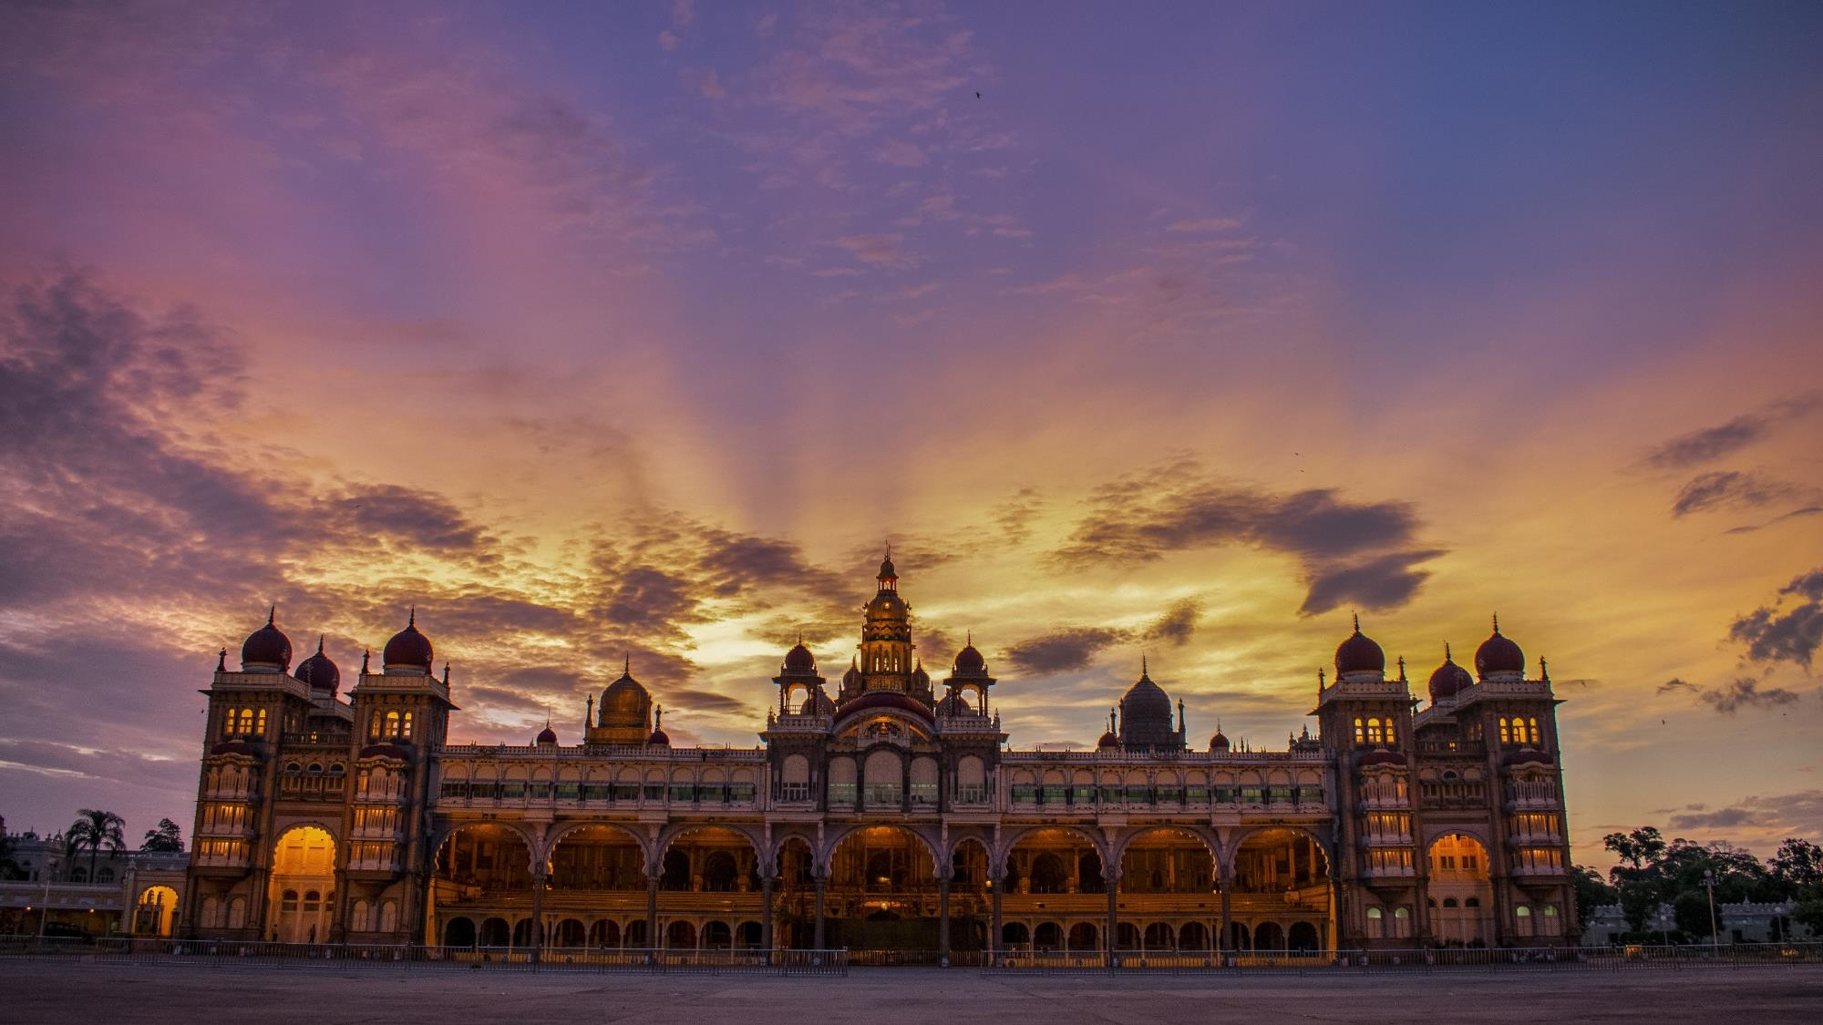
The “One State, Many Worlds" of Karnataka Tourism
02 March 2021
By Dr. Rakesh Kumar K
Director, Tourism

Slide 2
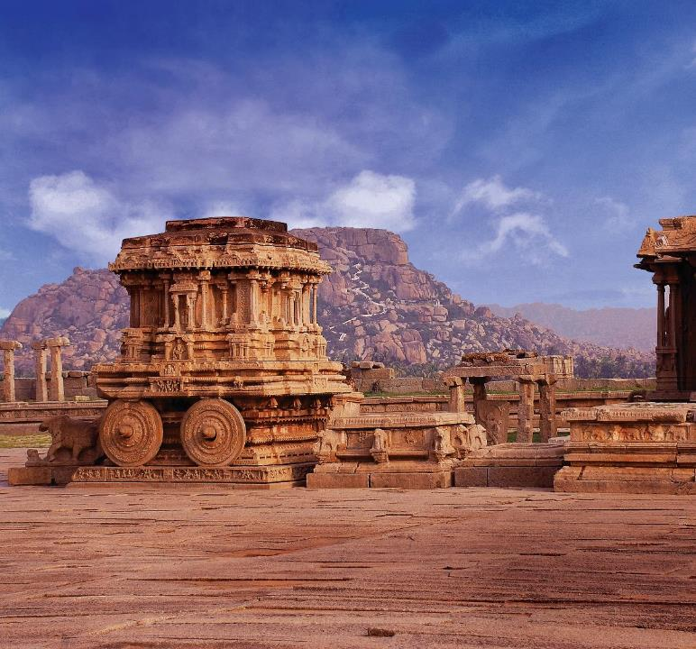
Overview of Tourism in Karnataka

Slide 3

Key Facts for Karnataka Tourism
14.8%
Tourism’s contribution to Karnataka’s GSDP
>30 Lakh
Employment in Karnataka’s Tourism Sector
4th
Domestic Tourist Visits
11th
International Tourist Visits
770+
Identified Tourism Destinations
3rd
Kempegowda International Airport’s ranking for FTAs

Slide 4
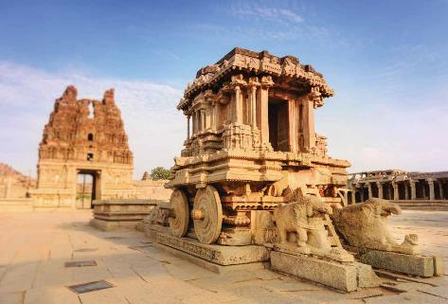
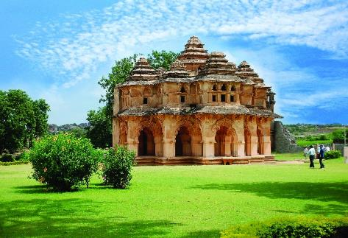
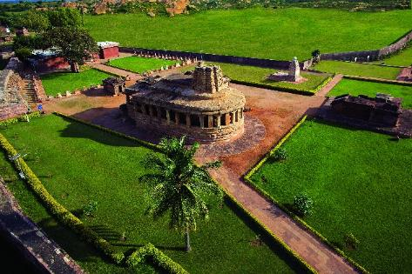
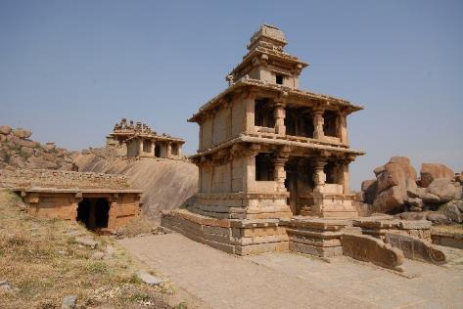
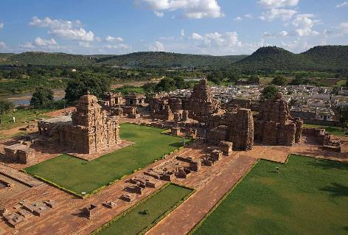
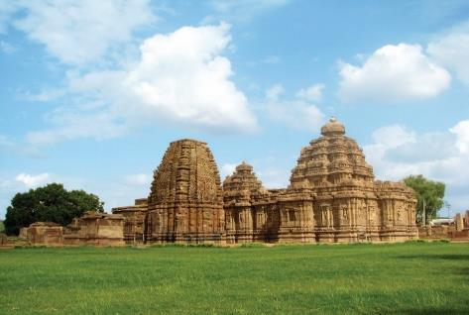
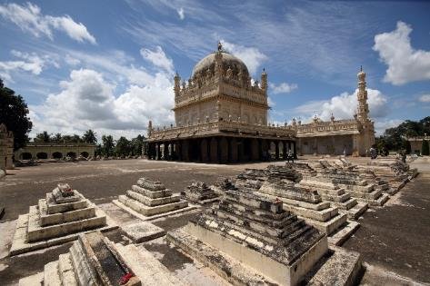
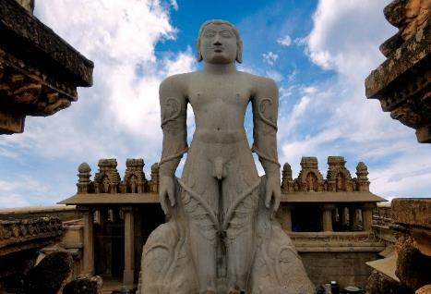
Tourism Potential of Karnataka
3 UNESCO World Heritage Sites – Hampi, Pattadakal, Western Ghats
Over 600 ASI-protected monuments and 844 state-protected monuments
Hampi World Heritage Site
Aihole
Chitradurga
Pattadakal Group of Monuments
Srirangapatna
Shravanabelagola

Slide 5
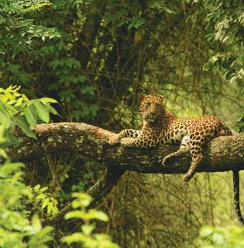
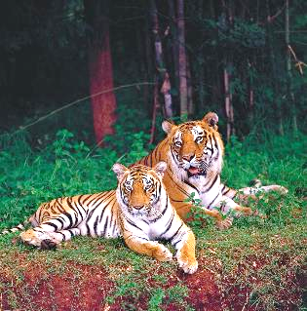
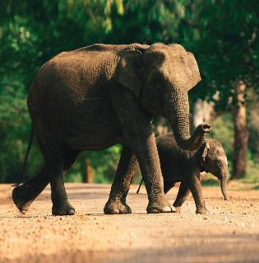
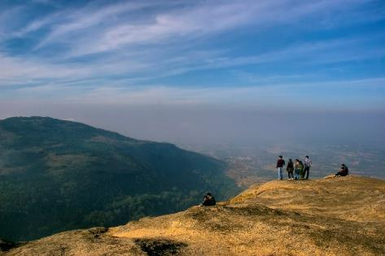
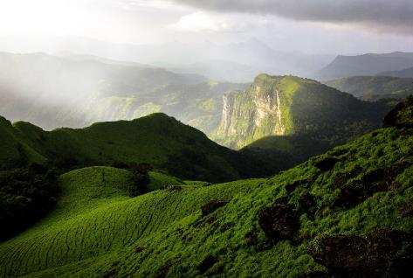
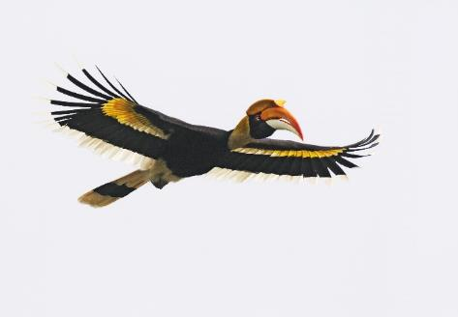
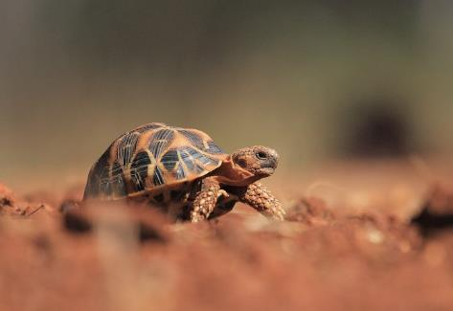
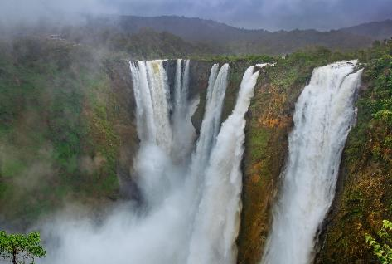
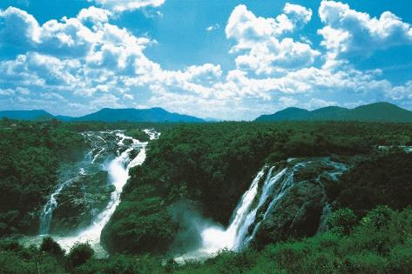
Tourism Potential of Karnataka
5 National Parks and 30 Wildlife Sanctuaries
17 Hill Stations and 40 Waterfalls
Nandi Hills
Chikkamagaluru
Jog Falls
Shivanasamudra

Slide 6
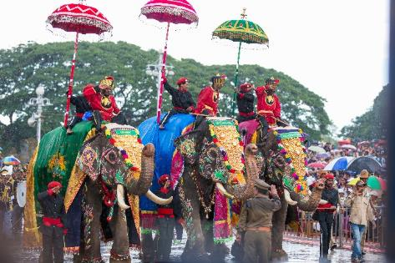
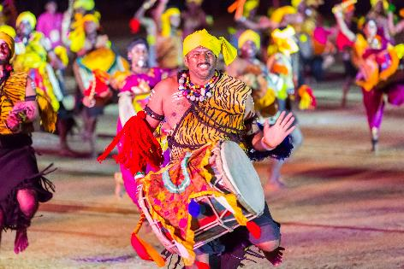
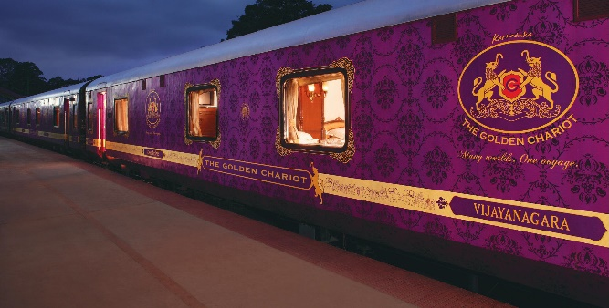
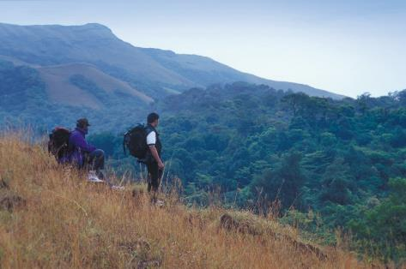

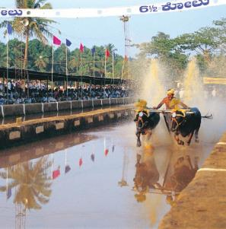

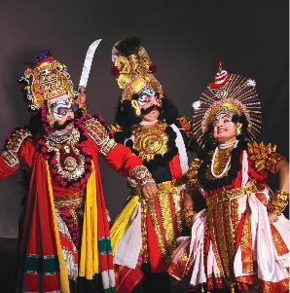
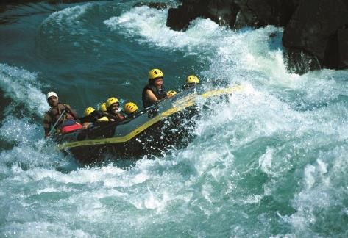
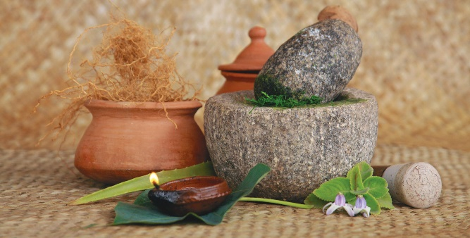
Tourism Potential of Karnataka
Incredible Diversity of Cuisine, Crafts and Culture
Memorable experiences of Luxury and Adventure
Mysuru Dasara
Dollu Kunitha
Kambala
Channapatna Toys
Yakshagana

Slide 7
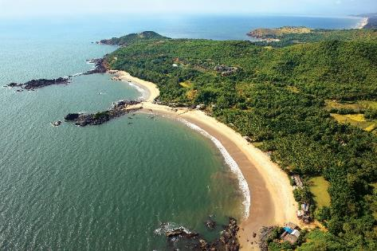
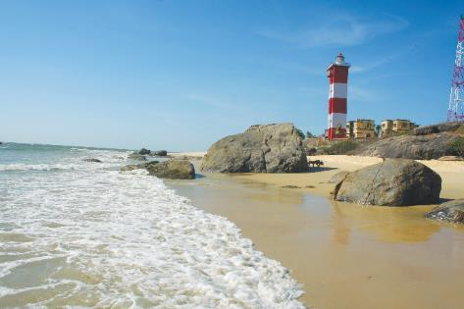
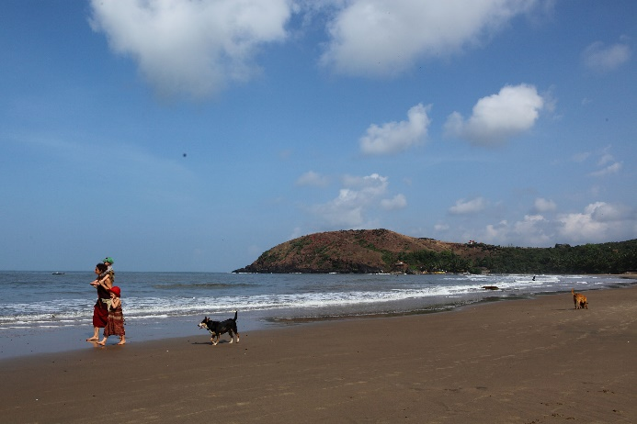
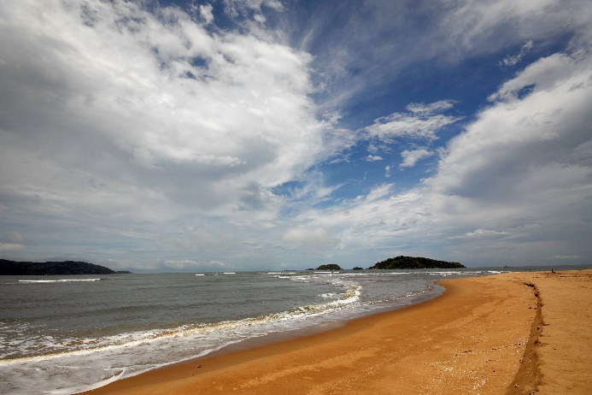
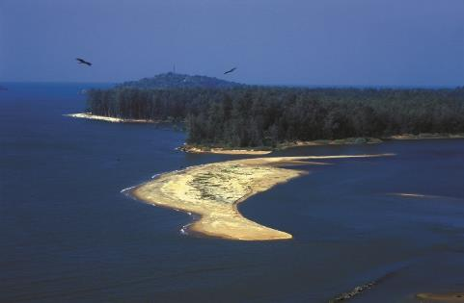
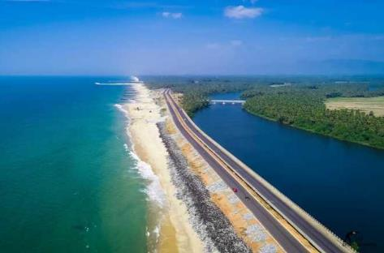
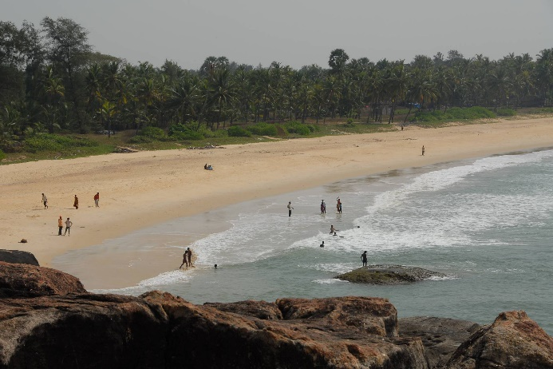
Tourism Potential of Karnataka
320 Kms Coastline with pristine beaches and coastal activities
Gokarna
Surathkal
Kudle
Devbagh
Karwar
Maravanthe
Kaup
Kaup

Slide 8
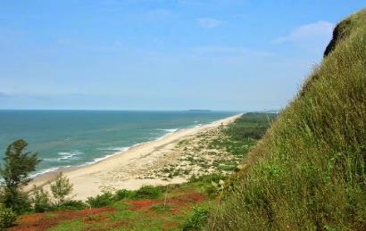
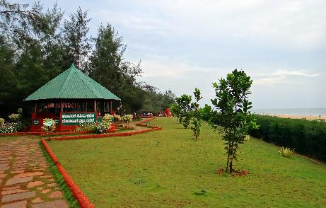
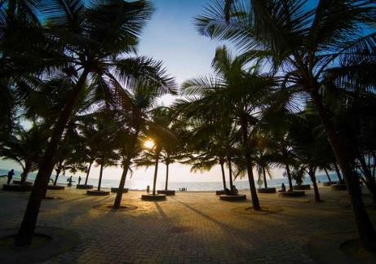
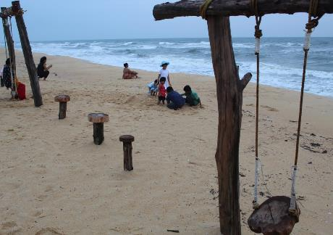
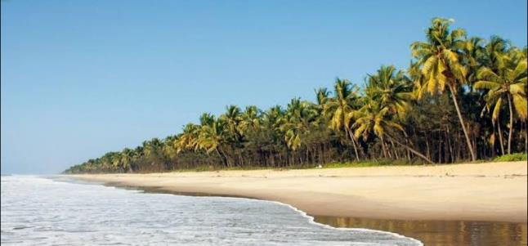
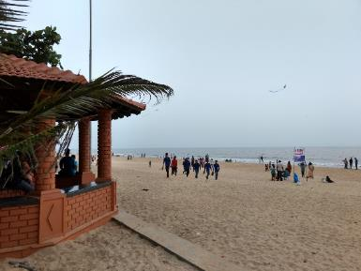
Blue Flag Certification for Karnataka Beaches
Karnataka is the only Indian state with two beaches with Blue Flag Certification
Awarded by Foundation for Environmental Education by eminent international jury comprising of, which comprises members of the United Nations Environment Programme (UNEP), United Nations World Tourism Organization (UNWTO), Foundation for Environmental Education (FEE) and International Union for Conservation of Nature (IUCN)
Environment
Education
Safety
Accessibility
Kasarkod Beach (Uttara Kannada)
Padubidri Beach (Udupi)

Slide 9
Coastal Circuits to explore Karnataka’s many worlds
Key Coastal Circuits
Karwar – Dandeli – Sirsi – Gokarna
Gokarna – Murudeshwar – Jog Falls – Kollur – Maravanthe
Maravanthe – Agumbe – Maroe – Udupi
Udupi – Karkala – Mudbidri – Dharmasthala – Kukke Subramanya – Mangalore
Mangalore, Udupi and Karwar in particular are well connected through a variety of transport channels and hence are good entry and exit points for tourists.

Slide 10
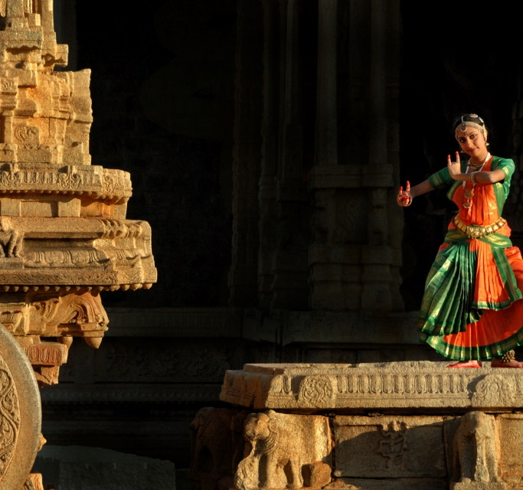
Support for Investments in Karnataka’s Tourism Sector

Slide 11

Karnataka Tourism Policy 2020-25
Expected Investments
Expected Employment
Tourism Projects Benefitted
Financial Assistance Sanctioned
INR 5,000 Crore
10 Lakh Jobs
350+
INR 450 Crore
Key Strategic Pillars for Karnataka Tourism Policy 2020-25
Tourism Marketing & Promotion
Tourism Infrastructure Development
Tourism Products
Skill Development & Training
Tourist Comfort & Safety
Community Participation
Sustainable Tourism
Tourism Analytics & Digital Initiatives
Investment Facilitation
Institutional Frameworks
Facilitation Mechanisms
Stakeholder Management
Ease of Doing Business

Slide 12










Subsidies under Karnataka Tourism Policy 2020-25
Capital Investment Subsidy
Hotel
Projects
Wellness Centres
Adventure Tourism
Wayside Amenities
Caravan
Parks
Houseboats
Interest Subsidy
Agri Tourism Project
Cultural Tourism Project
Heritage Tourism Project
Safety & Hygiene Tourism Project

Slide 13











Incentives and Concessions under Policy
Concessions
Stamp Duty Exemption
Land Conversion Fee Reimbursement
Complementary Infrastructure Assistance
Concessional Registration Charges
Motor Vehicle Tax Exemption
Incentives
Registration of Tourism Projects
Marketing Support
Marketing Development Assistance
Facilitation Support
Recognition & Assistance for Sustainability
Tourism Excellence Awards

Slide 14

Investment Facilitation for Tourism Projects
Investment Facilitation Cell
Investment Facilitation Cell to be created under Department of Tourism for enabling and facilitation of investments
Global Tourism Investors Meet
Global meet organized by DoT to showcase investment potential of Karnataka Tourism
Mega Tourism Projects
Special incentives, subsidies and concessions for tourism projects with value > INR 100 Crore
Ease of Doing Business
Facilitation support for all tourism projects to ensure accelerated development of tourism projects in Karnataka

Slide 15
Thank You
Shri. T. K. Anil Kumar, IAS
Principal Secretary to Government,
Tourism Department
T: +91 9448464333
E: acs-tour@karnataka.gov.in
Shri. K Rakesh Kumar, IAS
Director Tourism,
Government of Karnataka
T: +91 9900960321
E: director@karnatakatourism.org

