Slide 1
Marine Investment Opportunities in Karnataka
Virtual Maritime India Summit 2021
By: Capt. C. Swamy, Director Ports
Strictly private and confidential
March 2021

Slide 2
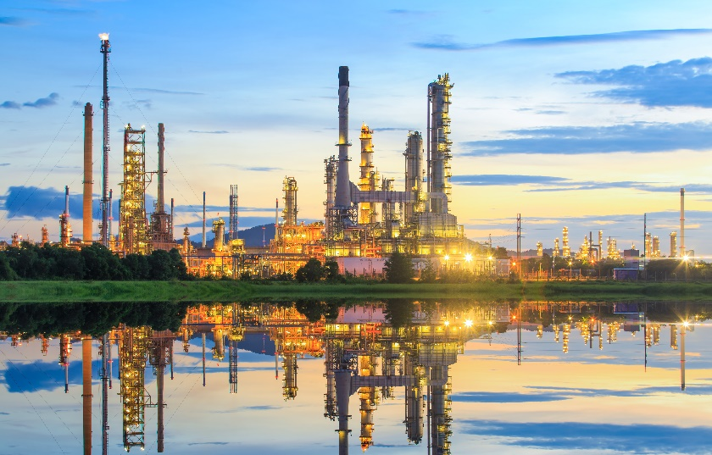
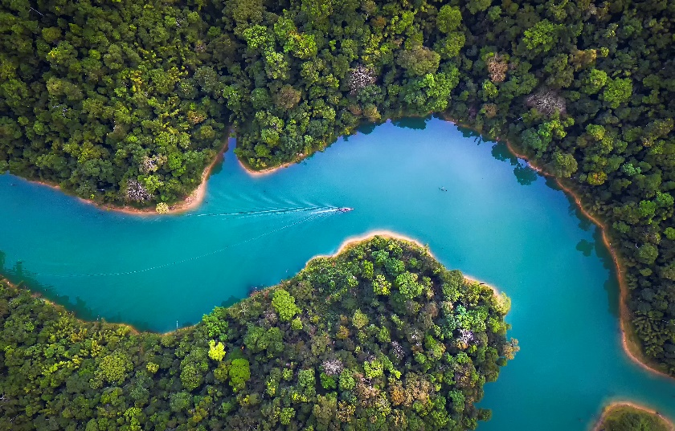
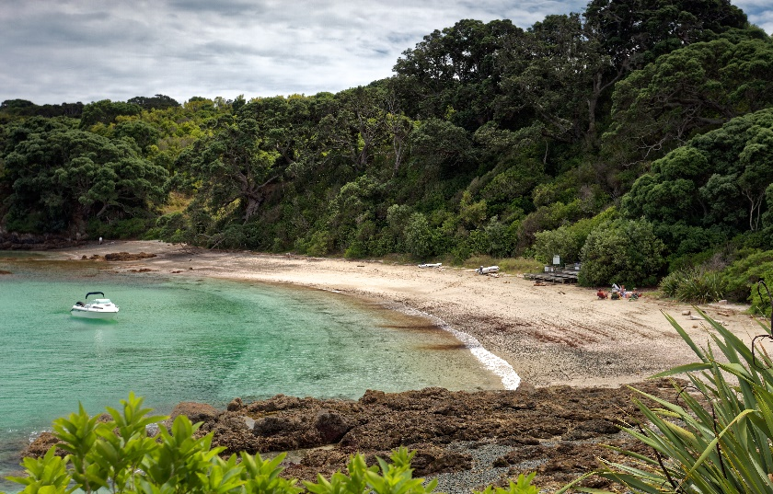
Developed industrial hinterland and picturesque coastal landscape provides multitudes of opportunities in maritime sector
Developed industrial hinterland
Waterways
Serene beaches and picturesque landscape
Karnataka has well-developed industrial hinterland distributed across the State
State has several waterways including Kali, Suvarna, and Gurupur which can be considered for tourism development.
State has a long coast line with tourist spots such as Karwar, Kundapura, Gokarna, Udupi, etc. and wildlife sanctuaries

Slide 3
State has a very well developed industrial hinterland with power, steel, cement, petrochemicals, aerospace, automotive, etc. among major sectors
Major Industries in Karnataka
Legend
A developed industrial hinterland provides gateway cargo and is extremely important for the development of any port
Thermal Power
Bagalkot
Gulbarga
Aerospace
Pharma
Belgaum
Automotive
Raichur
Steel
Koppal
Cement
Dharwad
Agro & Food
Key Features of Karnataka hinterland
Bellary
Chitradurga
Machine Tools
Chikmangaluru
Petrochemicals
~40 MTPA of cement capacity
~25 MTPA of iron & steel capacity
~10 GW of installed thermal power plant
Udupi
Tumkur
Dakshina Kannada
Hassan
Kolar
Bengaluru
Mysuru
Source: Karnataka State Industrial Profile, Capex, Company websites & presentations, SIAM, KIADB,

Slide 4
Gross state domestic product (GSDP) growth rate of the State is 2nd highest among maritime states
GSDP CAGR of Maritime States of India
(at constant price FY 12 – FY 19)
India GDP Growth Rate ~7%
A high GSDP CAGR indicates good potential for future growth in cargo for the ports
*Source- Economic & Statistical organisation, Punjab

Slide 5
State has one major and 12 non-major ports
Major and non-major ports in Karnataka
Traffic handled at Karnataka non major ports
Karnataka Maritime Board is constituted to facilitate development of maritime infrastructure in the State
All figures in ‘000 MT
Goa
Karwar
Belekeri
 | Develop new non-major ports in the State
 | Increase throughput of ports
 | Ship building & Ship breaking infrastructure
 | Inland water transport system
 | Tourism development - in & around the Coast
 | Fishing harbours and other infrastructure
Tadri
Pavinkuruve
P- Provisional
Honnavar
# Note: During the period APR – DEC 2019-20, Directorate of Ports, Karnataka, recorded a growth of 25% against the corresponding period of the previous fiscal
Manki
Bhatkal
Non-Major ports in Karnataka have untapped potential and there is a need for infrastructure development
Port at Honnavar being developed by a private firm
Kundapur
Hangarkatta
Malpe
Padubidri
KMB is looking forward to private sector participation in the development of requisite infrastructure
New Mangalore port
Coastline
Old Mangalore
Non-major Ports
Major Ports
# Source: The Hindu Business Line

Slide 6
Maritime board focuses on 5 areas for development of maritime sector in the State
Themes for maritime sector development
Port facilities for existing cargo
Coastal cargo through port based storage cum distribution centres
Encouraging development of port based industries
Karnataka Maritime Board developed Maritime Perspective Plan for the State to identify opportunities for maritime sector development
Development of alternate hinterland connectivity mode
Maritime led tourism
Perspective plan provided outputs across 5 themes

Slide 7
Maritime perspective plan provided outputs highlighting requirement of maritime sector development across 5 themes
 | Theme | Outputs
1 | Port facilities for existing cargo | ~ 10 MTPA of cargo including thermal coal, pet coke, liquid bulk, general cargo and container by FY’35
2 | Coastal cargo through port-based storage cum distribution centers | ~3 MTPA of coastal cargo including cement, food grains and fertilizers by FY‘35
3 | Port based industries development | Establishing fish processing units, warehouse & VAS facilities for agro trade, fertilizers, etc., logistics parks and industrial parks
4 | Alternate hinterland connectivity | Movement of iron ore through slurry pipeline
5 | Maritime led tourism | Houseboats, river cruise, luxury yachts & sailing boats, marine, cruise ship, catamarans, heli-tourism, water sports institute

Slide 8
Proposed infrastructure development will boost economic growth and create direct and indirect job opportunities
Economic impact from port infrastructure development
Proposed infrastructure will bring ~ Rs 15,000 crore of economic value addition (direct and indirect) by FY’35
Logistics cost saving including coastal movement of goods and slurry pipeline – Rs 130 crore/ year
Each direct port employment is directly associated with about 3-4 indirect jobs; Expected to create ~ 10-15,000 direct and indirect job opportunities
Economic Value Addition
~Rs 15,000 crore
Port Impact
Logistics cost savings
~Rs 660 crore per Year
Jobs created
10,000 – 15,000 by FY’35
Economic value addition and jobs created are based on OECD report titled ‘The Competitiveness Of Global Port-cities: Synthesis Report’.
On average, 1 MT of throughput is associated with USD 100 of economic value addition and 1 MMT of port throughput is associated with 800 direct and indirect jobs

Slide 9
We invite private players to participate in the development of maritime infrastructure in the state of Karnataka
Non major port development
Infrastructure development at existing port
KMB has taken initiatives to enhance ease of doing business and increase private participation
We are evaluating non major port development at Belekeri and Pavinkurve in Uttar Kanada district
Open to any unsolicited proposal as well
Phase 2 development of Karwar port is underway
Development works at Old Mangalore port under consideration
Port based storage cum distribution centre
Cement silos for bulk movement of cement
Warehouse cum distribution centre for agro and other industries
Revision of state port policy to encourage private investment
MCA development aligned with the state port policy
Development of guideline document for port-based logistics infrastructure and maritime led tourism
Fisheries infrastructure development
Maritime led tourism development
Development of fishing harbour such as Majali, etc. and associated logistics infrastructure
Maritime led tourism projects such as houseboat, river cruise, luxury yacht, catamarans, marina, cruise tourism etc

Slide 10
Thank You

